Slide 1
Hiroshi Sugimoto
Presented By Sinead R.

Slide 2
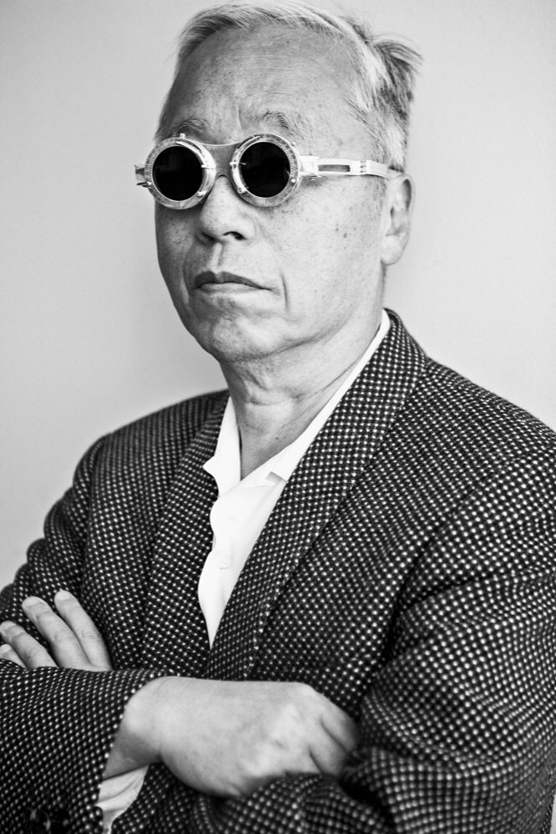
Sugimoto’s Life
Born: Tokyo, Japan
Retrained as an artist at Art Center College of Design, California in 1974
8×10 large-format camera and extremely long exposures
Expressed a great deal of interest in late 20th century modern architecture.

Slide 3
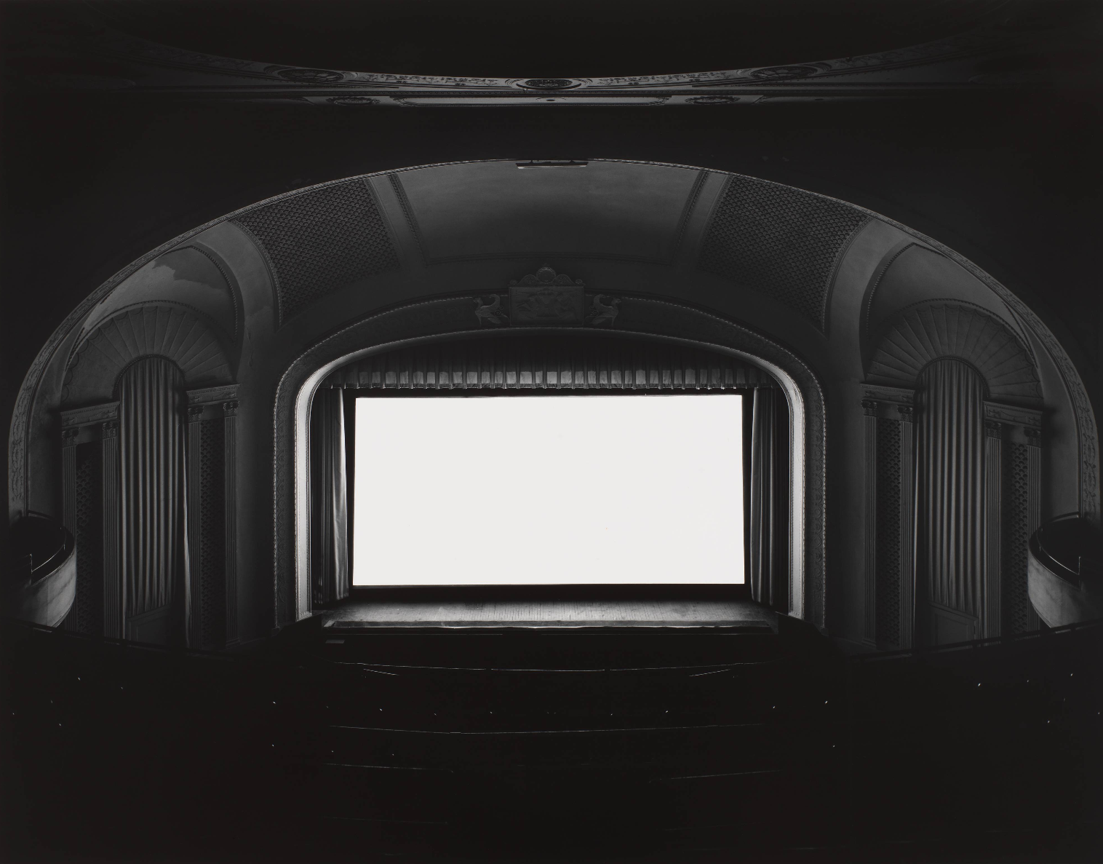
U.A. Playhouse, New York, Great Neck, Hiroshi Sugimoto (Gelatin Silver Print ,1978)

Slide 4
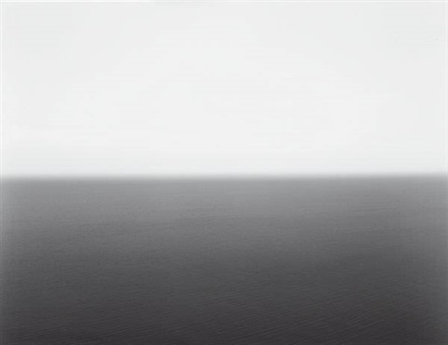
Marmara Sea, Silivri, Hiroshi Sugimoto
(Gelatin Silver Print, 1991)

Slide 5
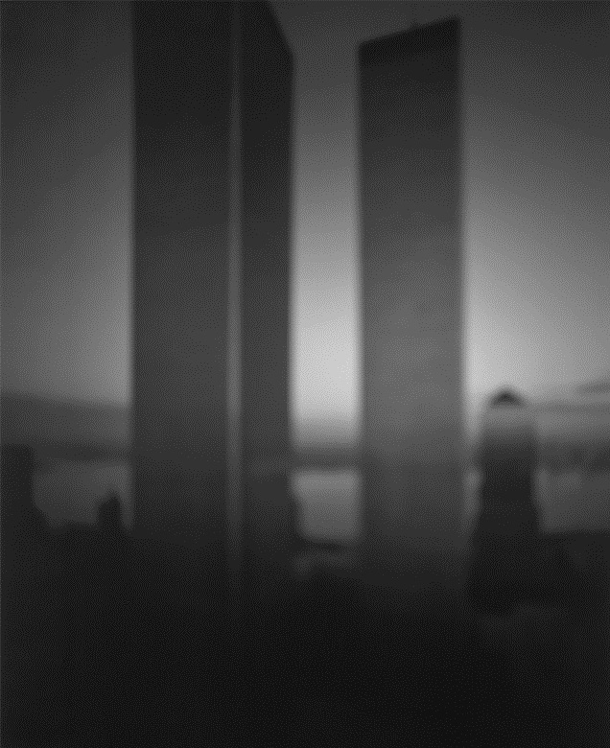
World Trade Center, Hiroshi Sugimoto (Gelatin Silver Print, 1997)

Slide 6
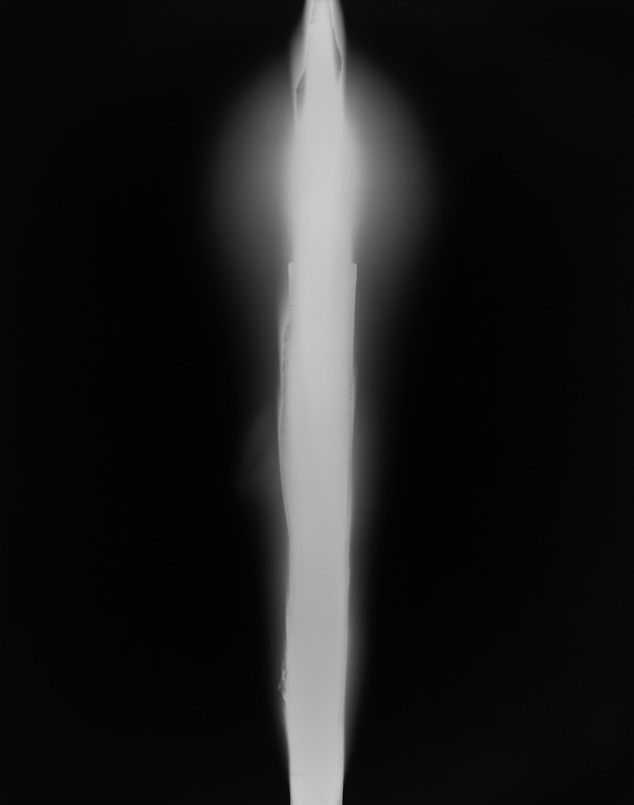
In Praise of Shadows 980816, Hiroshi Sugimoto (Gelatin Silver Print, 1998)

Slide 7
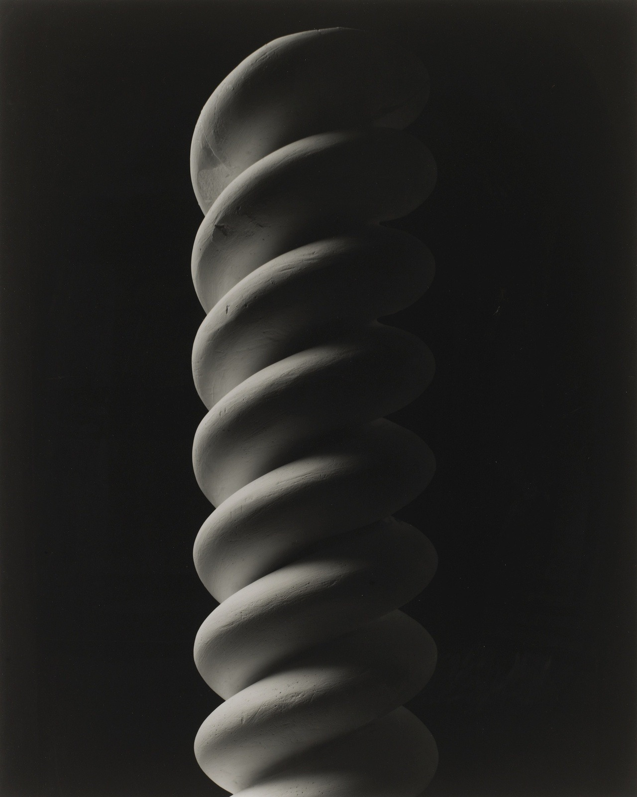
Mathematical Form: Surface 0013, Hiroshi Sugimoto (Gelatin Silver Print, 2004)

Slide 8

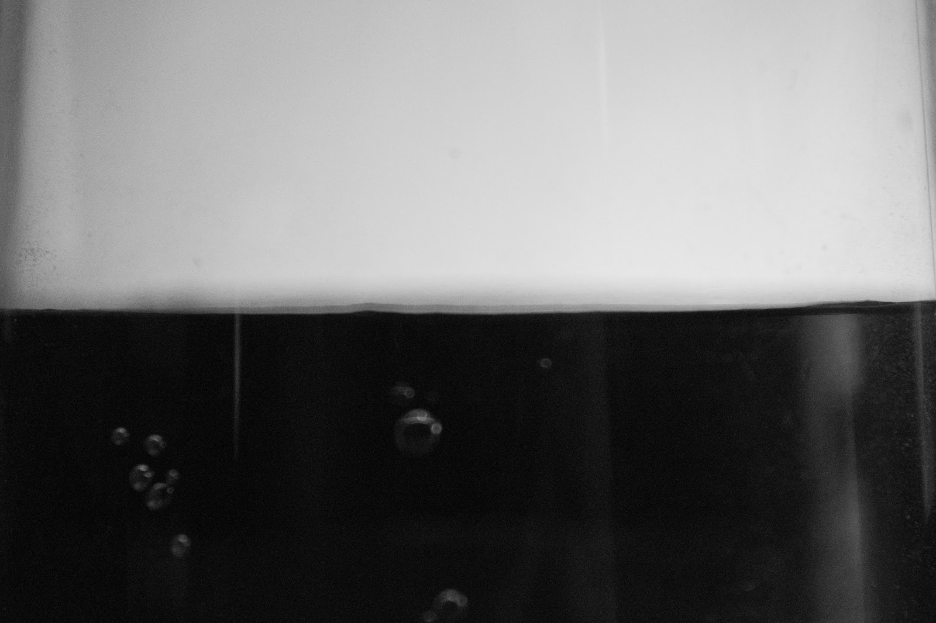
My Photography
Homebound, Sinead Rafferty
(2019) - Inspired by U.A. Playhouse, New York, Great Neck
Fictional Horizon, Sinead Rafferty
(2019) – Inspired by Marmara Sea, Silivri

Slide 9
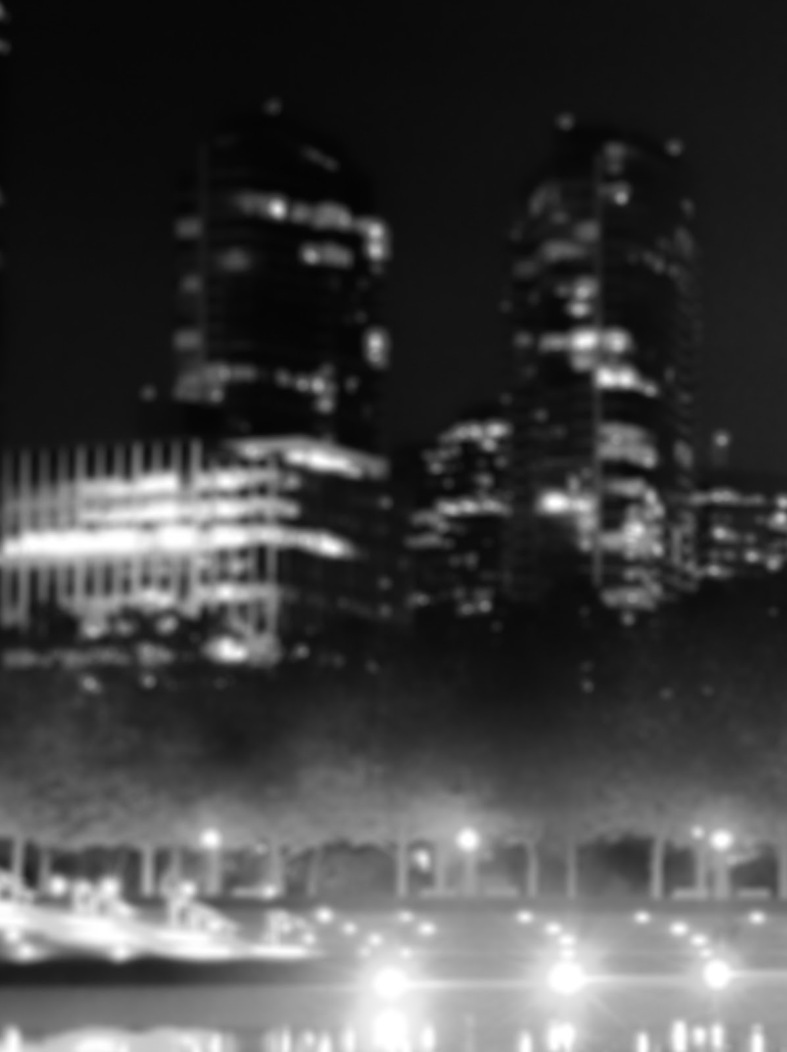
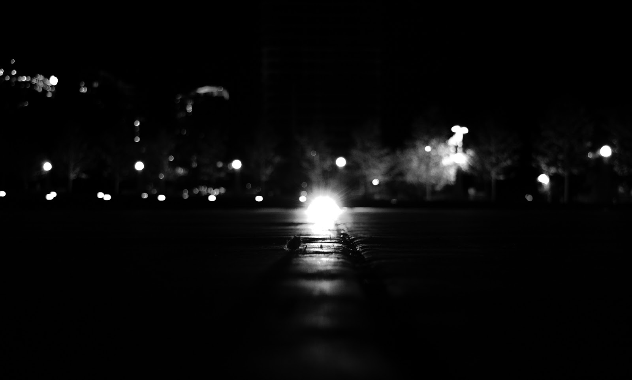
Night of Stars, Sinead Rafferty
(2019) – Inspired by World Trade Center
Haven, Sinead Rafferty
(2019) – Inspired by In Praise of Shadows

Slide 10
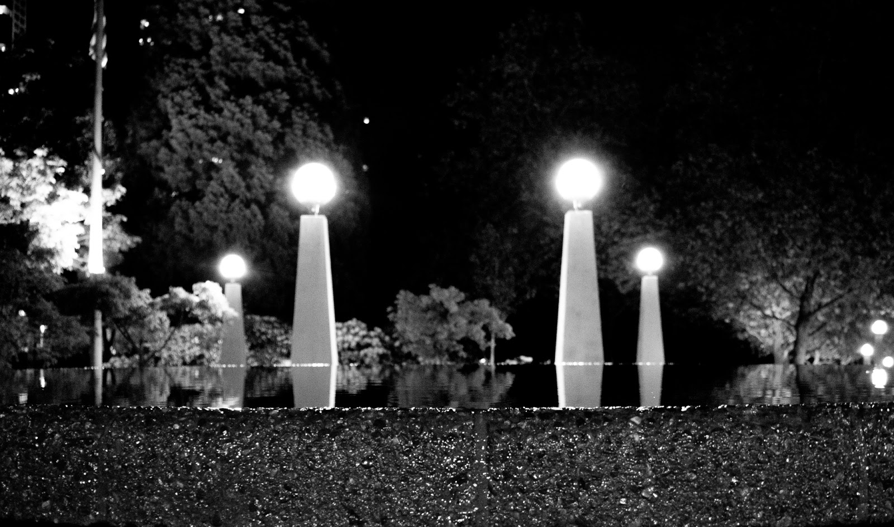
Balance, Sinead Rafferty
(2019) – Inspired by Mathematical Form: Surface 0013

Slide 11
Bibliography
Bashkoff, Tracey, and Nancy Spector. Sugimoto: Portraits. Guggenheim Museum, 2000.
Sugimoto, Hiroshi, et al. Hiroshi Sugimoto : Theaters. Damiani ; Matsumoto Editions, 2016.
Sugimoto, Hiroshi, and Mark-Ken Erdmann. Hiroshi Sugimoto - Gates of Paradise. Skira Rizzoli, 2017.
Li, Jennifer. (2014) Hiroshi Sugimoto. Art and AsiaPacific, , 166.
Wittmann, M., “Time, extended: Hiroshi Sugimoto with Gilles Deleuze”. Image [&] Narrative [e-journal], Vol.X, issue 1 (2009).
Matsumoto, Takaaki, and Hiroshi Sugimoto. Hiroshi Sugimoto: Theaters. Damiani, 2016.
Hoare P. The ocean’s skin. Architectural Review. 2019;(1460):6-12.

